Slide 1

#LifeKoKaroLift
Be sincere, not serious !

Slide 2



Session On : Object Oriented Programming
& Profile Building

Slide 3
History
Object Oriented Programming ?

Slide 4

OOP : History

Slide 5
OOP : An Overview
Plain Calculus
Assembly Lang
Shortcode
Autocode
Fortran
Algol
LISP
Cobol
Basic
Pascal
Smalltalk
C

Slide 6
OOP : An Overview
“[…] the whole point of OOP is not to have to worry about what is inside an object. Objects made on different machines and with different languages should be able to talk to each other […]”

Slide 7
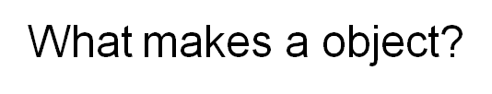
OOP : An Overview
Notes:
An object is an entity that has states and behaviors.

Slide 8
OOP : Object
Person
Name
Height
Weight
Color
Eat
Sleep
Code
Walk

Slide 9
OOP : Building Blocks
Object
Class
Attributes
Functions

Slide 10
OOP : Building Blocks
Template
Person
Name
Height
Weight
Color
Eat
Sleep
Code
Walk
Data
Functionality

Slide 11
OOP : Building Blocks
Object Oriented Programming Principles

Slide 12

Encapsulation

Slide 13
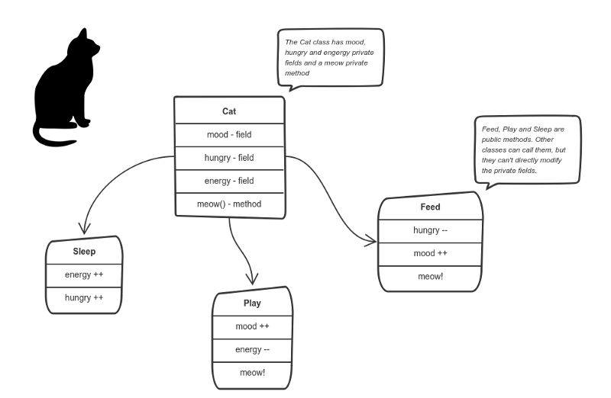
Encapsulation

Slide 14

Abstraction

Slide 15
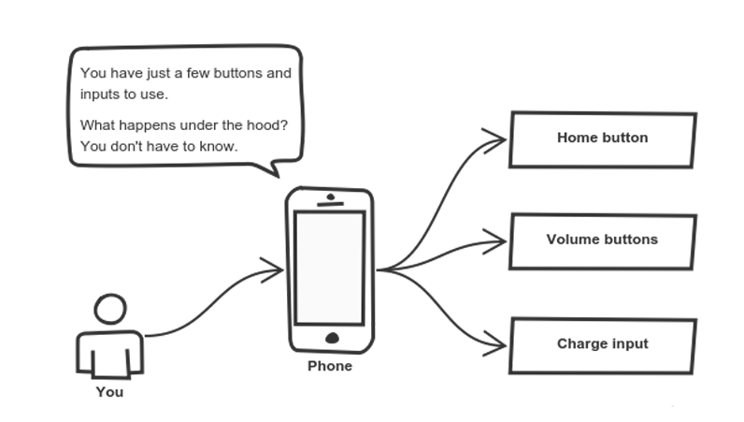
Abstraction

Slide 16
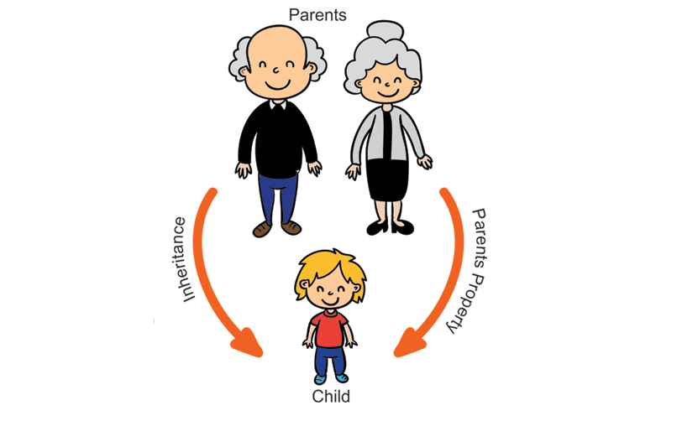
Inheritance

Slide 17
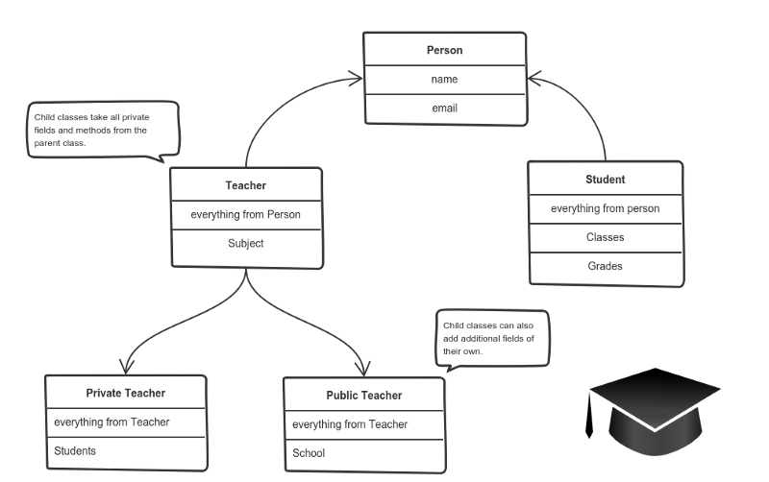
Inheritance

Slide 18
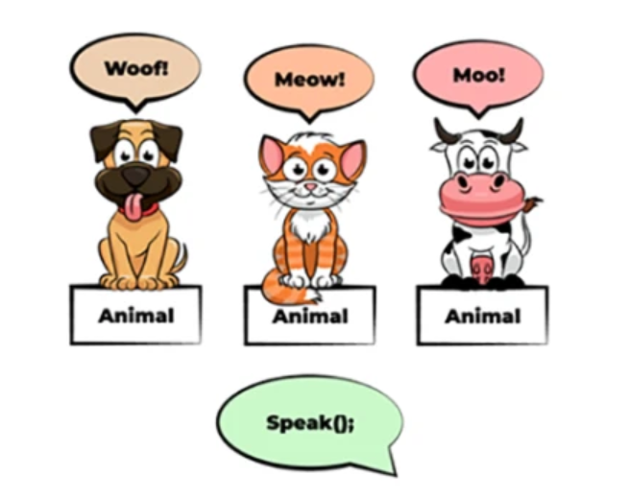
Polymorphism

Slide 19
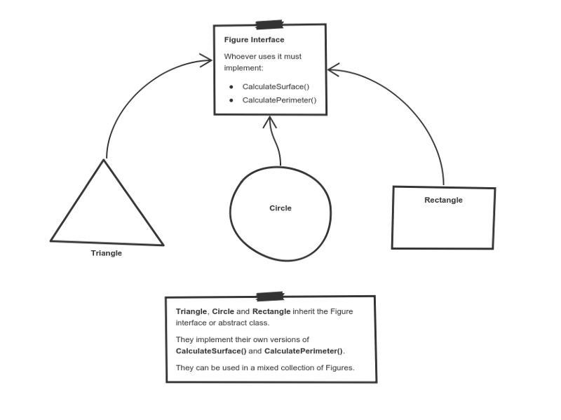
Polymorphism

Slide 20
OOP : Best Practices
How to design objects?

Slide 21
OOP : Best Practices
What makes a good OO design ?

Slide 22
Which language to learn?

Slide 23
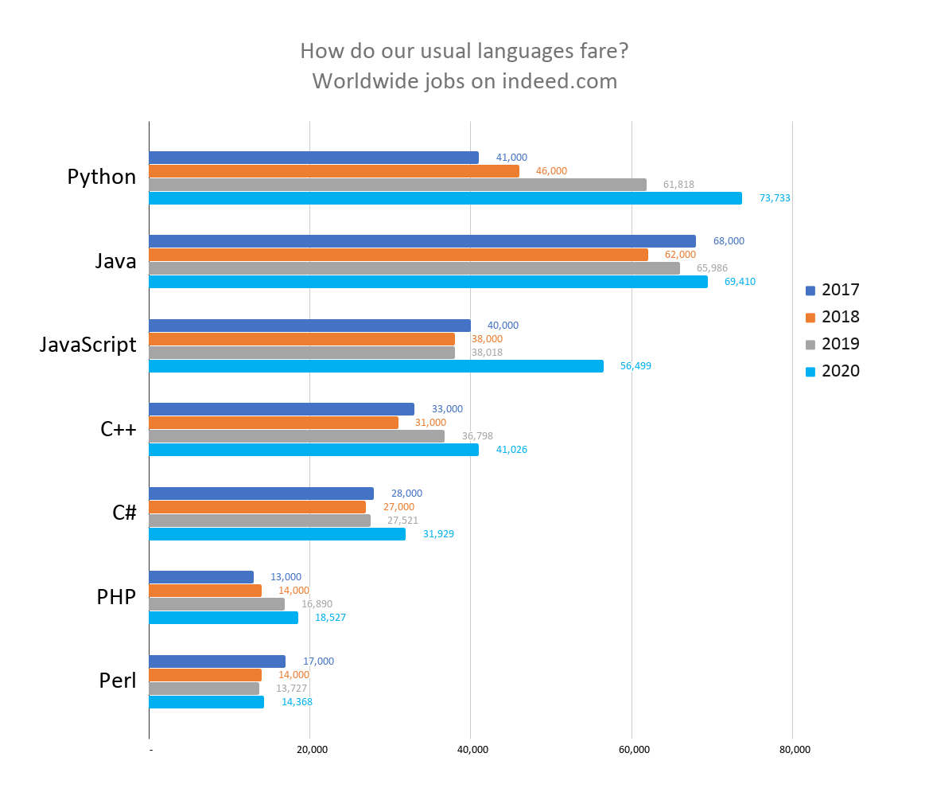

Slide 24
Stay Relevant !

Slide 25
How to stay relevant?

Slide 26
There are no silly questions!

Slide 27
#LifeKoKaroLift
Thank You!

